Slide 1
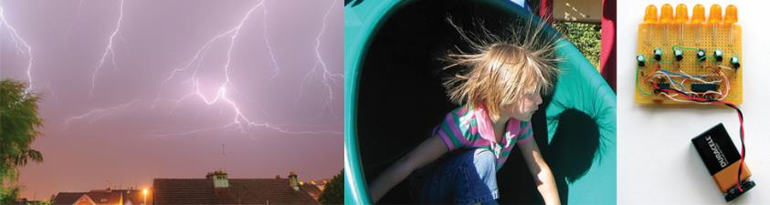
Electrochemistry

Slide 2
Electrochemistry
Electrochemistry: The branch of chemistry that examines the transformations between chemical and electrical energy
Review of Redox Reactions:
Sum of two half–reactions
One species gains e– (reduction) while another species loses e– (oxidation)
Oxidizing agents vs. reducing agents
Covered extensively in 1210

Slide 3
Pilot Slides vs TopHat?
Why both?
In the regular class we use the ppt version to be able step through the animation. Now this might help you see it more clearly if it is not immediately filled with stuff.
The non–live TopHat can’t animate.
TopHat doesn’t always render the slide right as some of you have notice. If it doesn’t you can look at the Pilot PPT version.
Question/problems. TopHat is not easy with superscripts and subscripts. They’re working on. So, as in class I recommend working from the ppt slide, then going to the TopHat question.
Then why put the slides on TopHat?
Mostly as a placeholder to make it easier to know where that question fits in the content.
Also, if the slides in TopHat are working well, then you don’t have to jump back and forth.

Slide 4
Video of following slides:
Balancing Redox
Oxidation to Balancing Redox

Slide 5
Oxidation–Reduction Reactions
Oxidation: loss of one or more electrons by a substance or a reaction that increases oxygen content of a substance
Reduction: gain of one or more electrons by a substance or a reaction that decreases the content of oxygen of a substance
Oxidation–Reduction (Redox) Reaction: Any process in which electrons are transferred from one substance to another
Fe gains oxygen
4Fe (s) + 3O₂ (g) → 2Fe₂O₃ (s)
Fe loses oxygen
2Fe₂O₃ (s) + 3C (s) → 4Fe (s) + 3CO₂ (g)
“LEO GER”

Slide 6
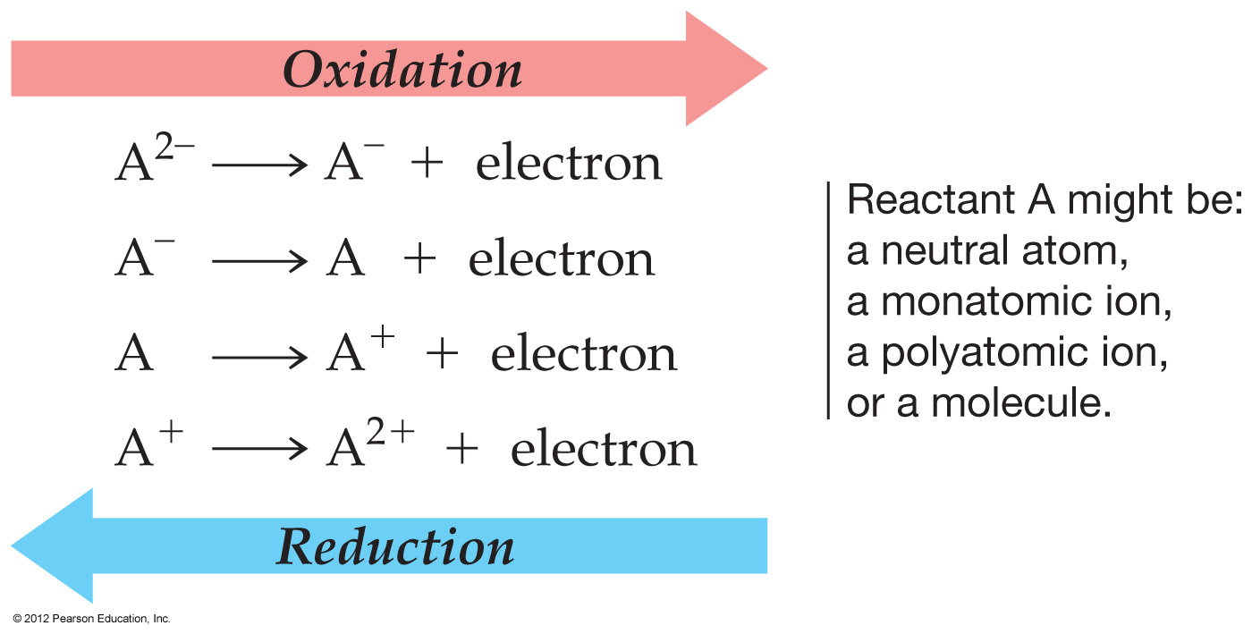
Oxidation–Reduction (Redox) Reactions
Rusting of iron:
an oxidation of Fe
4Fe (s) + 3O₂ (g) → 2Fe₂O₃ (s)
Manufacture of iron:
a reduction of Fe₂O₃
4Fe (s) + 3CO₂ (g) ← 2Fe₂O₃ (s) + 3C (s)

Slide 7
Oxidation Numbers (O.N.)
Oxidation Number (State): A value which indicates whether an atom is neutral, electron–rich, or electron–poor.
Rules for Assigning Oxidation Numbers
An atom in its elemental state has an oxidation number of 0.
Na
H₂
Br₂
S
Ne
0
0
0
0
0
An atom in a monatomic ion has an oxidation number identical to its charge.
Na⁺
Ca²⁺
Al³⁺
Cl–
O^{2–}
+1
+2
+3
–1
–2

Slide 8
Oxidation Numbers (O.N.)
An atom in a polyatomic ion or in a molecular compound usually has the same oxidation number it would have if it were a monatomic ion.
a) Hydrogen can be either +1 or –1 (though is predominately +1)
OH–
CaH₂
–2
+1
+2
–1
(x 2)
Oxygen usually has an oxidation number of –2.
H₂O
H₂O₂
+1
(x 2)
–2
+1
(x 2)
–1
(x 2)
Halogens usually have an oxidation number of –1.
HCl
OCl₂
+1
–1
–2
+1
(x 2)
Notes:
This is why charges are supposed to be written as “1–”. The corresponding oxidation number is written “–1”.

Slide 9
Oxidation Numbers (O.N.)
The sum of the oxidation numbers is 0 for a neutral compound and is equal to the net charge for a polyatomic ion.
H₂SO₄
2(+1) + (?) + 4(–2) = 0 (net charge)
+1
(x 2)
?
–2
(x 4)
? = +6
Cr₂O₇^{2–}
2(?) + 7(–2) = –2 (net charge)
?
–2
(x 7)
? = +6

Slide 10
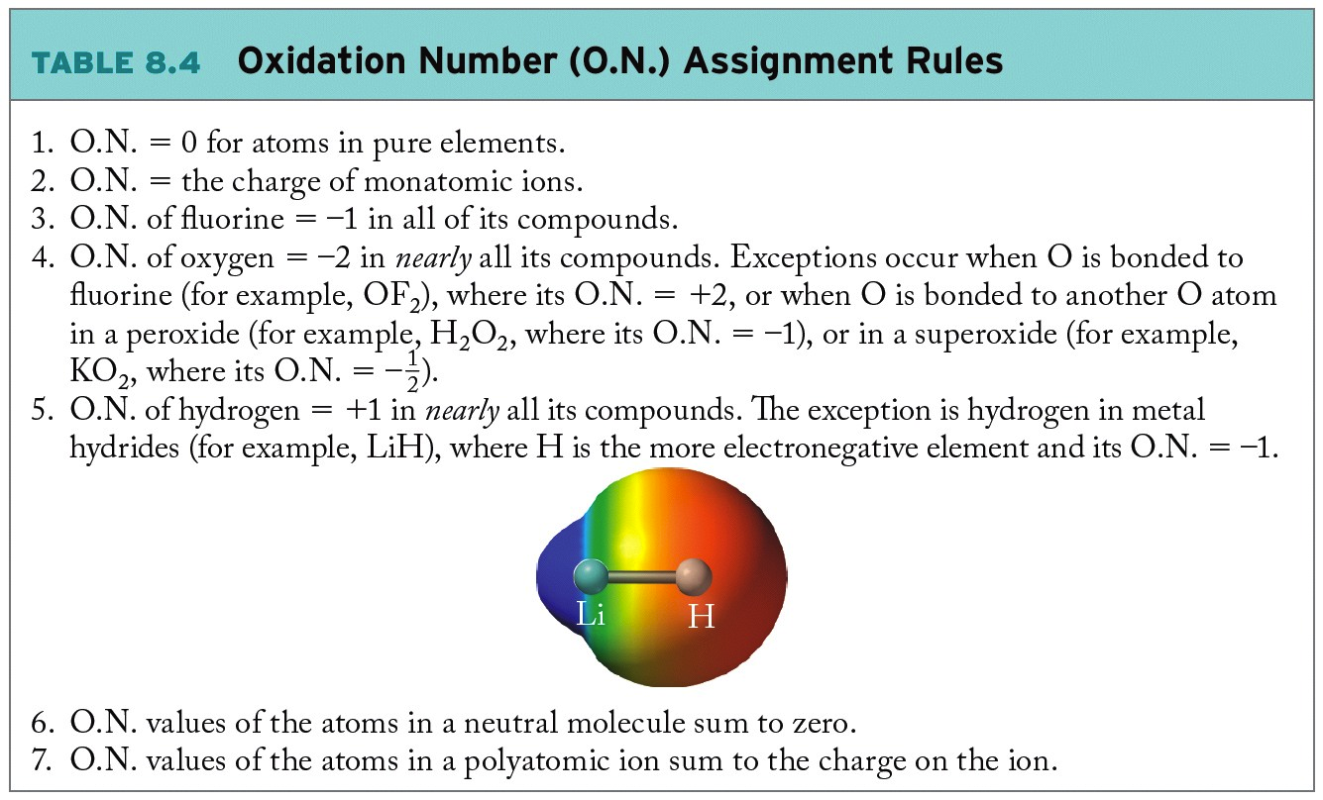
Oxidation Numbers (O.N.)

Slide 11
Example: Assigning Oxidation Numbers
Assign oxidation numbers to each element in the following compounds.
SO₂
CrO₄^{2–}
NH₃
+4
–2
(x 2)
+6
–2
(x 4)
–3
+1
(x 3)
ClO₃–
SF₆
Cl₂
+5
–2
(x 3)
+6
–1
(x 6)
0
Chlorine can have a lot of weird oxidation numbers, especially when paired with more highly electronegative atoms.

Slide 12
Video of following slides:
Review Oxidation States
Oxidation to Balancing Redox
There is a detailed method for Redox on Pilot and a couple of worksheets.

Slide 13
Review: Identifying Redox Reagents
Oxidizing Agent
Causes oxidation
Gains one or more electrons
Undergoes reduction
Oxidation number of atom decreases
Reducing Agent
Causes reduction
Loses one or more electrons
Undergoes oxidation
Oxidation number of atom increases
(Chapter 8)
Notes:
An “agent” causes something to happen.

Slide 14
Review: Redox Reactions
Change in oxidation states results from gain or loss of electrons:
Oxidizing agent
+2 electrons
+2
0
Zn(s) + Cu²⁺(aq) → Zn²⁺(aq) + Cu(s)
0
+2
Reducing agent
2 electrons
LEO GER
“loss of electron is oxidation”
“gain of electrons is reduction”
Notes:
Note: animation in two parts.

Slide 15
Review: Identifying Redox Reactions
oxidizing agent
+2 electrons
0
–2
4Fe (s) + 3O₂ (g) → 2Fe₂O₃ (s)
0
+3
reducing agent
3 electrons
Oxidation Number Assignment Rules (Chapter 8, p. 333)
oxidizing agent
+3 electrons
+3
0
2Fe₂O₃ (s) + 3C (s) → 4Fe (s) + 3CO₂ (g)
0
+4
reducing agent
4 electrons
Note that these are unbalanced, we need to take into account the redox changes (the electrons being transferred).

Slide 16
Balancing Redox Reactions:
Half–Reaction Method
Copper wire immersed in silver nitrate solution:
Cu(s) + 2Ag⁺ (aq) → Cu²⁺(aq) + 2Ag(s)
0
+1
+2
0
Can divide overall redox reaction into half–reactions:
Oxidation
Cu(s) → Cu²⁺(aq) + 2e–
Reduction
Ag⁺(aq) + e– → Ag(s)
Half–reactions may be balanced individually then added together to get the net ionic reaction.
Notes:
Animation in two parts:
1. start with reactants photo (a) + overall reaction
2. add half reactions + photo of products (b).

Slide 17
Balancing Redox Reactions:
Half–Reaction Method
Copper wire immersed in silver nitrate solution:
The other way around?
Oxidation
Cu(s) → Cu²⁺(aq) + 2e–
Reduction
Ag⁺(aq) + e– → Ag(s)
Half–reactions may be balanced individually then added together to get the net ionic reaction.
Both of those are pretty straight forward.
Not all redox reactions are so simple.
There is a detailed method for Redox on Pilot and a couple of worksheets.
Notes:
Animation in two parts:
1. start with reactants photo (a) + overall reaction
2. add half reactions + photo of products (b).

Slide 18
Review: Balancing Redox Reactions via
Half–Reaction Method
In acidic conditions, aqueous dichromate ion (Cr₂O₇^{2–}) is mixed with chloride ion (Cl–) to yield Cr³⁺ and aqueous chlorine gas. What is the balanced net ionic equation for this reaction?
Step 1: Write a preliminary reaction expression using one mole of each of the known reactants and products.
Cr₂O₇^{2–} (aq) + Cl– (aq) → Cr³⁺ (aq) + Cl₂ (g)
+6
–1
+3
0
Step 2: Write separate expressions linking the known reactants and products in the two–half reactions: one oxidation, one reduction.
Reduction
Cr₂O₇^{2–} (aq) → Cr³⁺ (aq)
Oxidation
Cl– (aq) → Cl₂ (g)

Slide 19
Review: Balancing Redox Reactions via
Half–Reaction Method
Step 3: Balance the number of particles in each half–reaction, not including H or O.
Cr₂O₇^{2–} (aq) → Cr³⁺ (aq)
2
2
Cl– (aq) → Cl₂ (g)
Step 4: Balance the number of oxygens using molecules of H₂O, then the number of hydrogens using H⁺. (If solution is basic, balance H⁺ by adding OH– to both sides, making water molecules)
14H⁺ (aq) +
Cr₂O₇^{2–} (aq) → 2Cr³⁺ (aq)
+ 7H₂O (l)
2Cl– (aq) → Cl₂ (g)

Slide 20
Review: Balancing Redox Reactions via
Half–Reaction Method
Step 5: Balance charge by adding electrons to the appropriate side.
6e– +
14H⁺ (aq) + Cr₂O₇^{2–} (aq) → 2Cr³⁺ (aq) + 7H₂O (l)
2Cl– (aq) → Cl₂ (g)
+ 2e–
Step 6: Multiply each half–reaction by the appropriate whole number so that the electrons match.
6e– + 14H⁺ (aq) + Cr₂O₇^{2–} (aq) → 2Cr³⁺ (aq) + 7H₂O (l)
3
2Cl– (aq) → Cl₂ (g) + 2e–

Slide 21
Review: Balancing Redox Reactions via
Half–Reaction Method
Step 7: Add the two half–reactions together, and cancel any terms that appear on both sides.
6e– + 14H⁺ (aq) + Cr₂O₇^{2–} (aq) → 2Cr³⁺ (aq) + 7H₂O (l)
+
6Cl– (aq) → 3Cl₂ (g) + 6e–
14H⁺ (aq) + Cr₂O₇^{2–} (aq) + 6Cl– (aq) → 2Cr³⁺ (aq) + 3Cl₂ (g) + 7H₂O (l)

Slide 22
Review: Balancing Redox Reactions via
Half–Reaction Method
Balance the given unbalanced net ionic equation as it would appear in basic solution:
Step 1: Write a preliminary reaction expression using one mole of each of the known reactants and products.
MnO₄– (aq) + Br– (aq) → MnO₂ (s) + BrO₃– (aq)
+7
–1
+4
+5
Step 2: Write separate expressions linking the known reactants and products in the two–half reactions: one oxidation, one reduction.
Reduction
MnO₄– (aq) → MnO₂ (s)
Oxidation
Br– (aq) → BrO₃– (aq)

Slide 23
Review: Balancing Redox Reactions via
Half–Reaction Method
Step 3: Balance the number of particles in each half–reaction, not including H or O.
MnO₄– (aq) → MnO₂ (s)
Br– (aq) → BrO₃– (aq)
Step 4: Balance the number of oxygens using molecules of H₂O, then the number of hydrogens using H⁺. (If solution is basic, balance H⁺ by adding OH– to both sides, making water molecules)
4OH– (aq) +
4H⁺ (aq) +
MnO₄– (aq) → MnO₂(s)
+ 2H₂O (l)
+ 4OH– (aq)
6OH– (aq) +
3H₂O (l) +
Br– (aq) → BrO₃– (aq)
+ 6H⁺ (aq)
+ 6OH– (aq)
Since we are in basic solution H⁺ is not prevalent, balance both sides with OH– equal in number to the H⁺ added.

Slide 24
Review: Balancing Redox Reactions via
Half–Reaction Method
Step 5: Balance charge by adding electrons to the appropriate side.
3e– +
4H₂O (l) + MnO₄– (aq) → MnO₂(s) + 2H₂O (l) + 4OH– (aq)
6OH– (aq) + 3H₂O (l) + Br– (aq) → BrO₃– (aq) + 6H₂O (l)
+ 6e–
Step 6: Multiply each half–reaction by the appropriate whole number so that the electrons match.
2
3e– + 4H₂O (l) + MnO₄– (aq) → MnO₂(s) + 2H₂O (l) + 4OH– (aq)
6OH– (aq) + 3H₂O (l) + Br– (aq) → BrO₃– (aq) + 6H₂O (l) + 6e–

Slide 25
Review: Balancing Redox Reactions via
Half–Reaction Method
Step 7: Add the two half–reactions together, and cancel any terms that appear on both sides.
6e– + 8H₂O (l) + 2MnO₄– (aq) → 2MnO₂(s) + 4H₂O (l) + 8OH– (aq)
6OH– (aq) + 3H₂O (l) + Br– (aq) → BrO₃– (aq) + 6H₂O (l) + 6e–
2MnO₄– (aq) + Br– (aq) + H₂O (aq) → 2MnO₂(s) + BrO₃– (l) + 2OH– (aq)

Slide 26
Video of following slides:
Electrochemical Cells and Cell Diagrams.
Here to Electromotive force.

Slide 27
Electrochemical Cell
Electrochemical Cell: Converts chemical energy into electrical work or electrical work into chemical energy
A bridge connects the two solutions of the cell; balances flow of electrons, eliminates accumulation of charge in either compartment

Slide 28
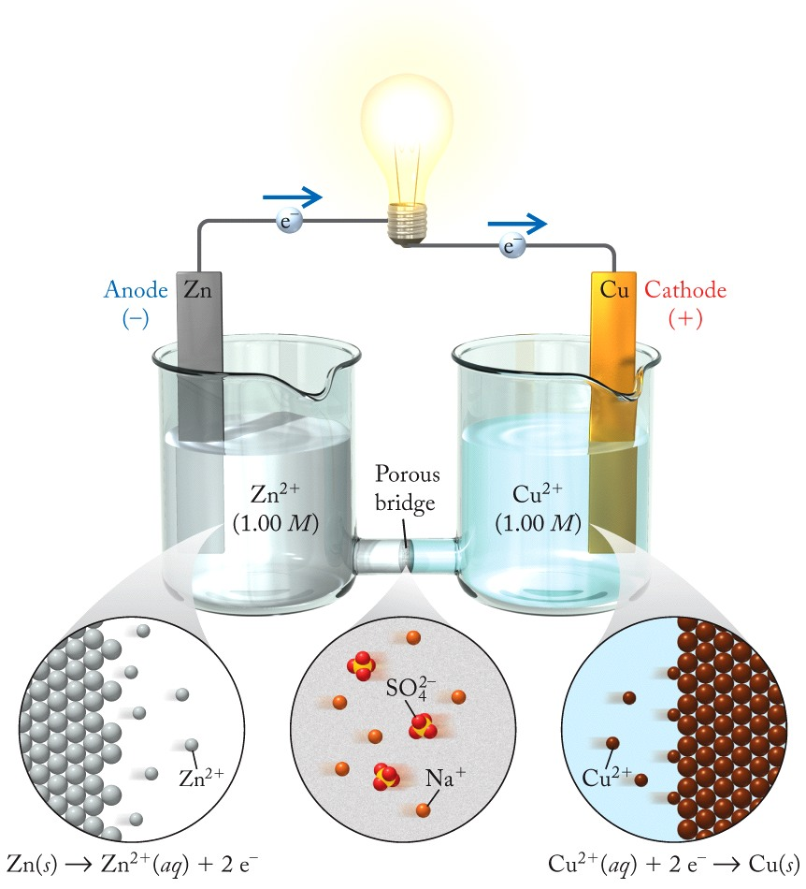
Electrochemistry
Zn(s) + Cu²⁺(aq) →
Cu(s) + Zn²⁺(aq)
Zn = Reducing Agent
Cu²⁺ = Oxidizing Agent

Slide 29
Cell Components
Anode: Electrode at which oxidation half–reaction (loss of electrons) takes place
Cathode: Electrode at which reduction half–reaction (gain of electrons) takes place
Cell Diagram: Symbols that show how the components of an electrochemical cell are connected

Slide 30
Writing Cell Diagrams
Cu(s) + 2Ag⁺(aq) → Cu²⁺(aq) + 2Ag(s)
being oxidized
being reduced
Step 1: Chemical symbol of anode at the far left, symbol of cathode at the far right, and a double vertical line between them to represent bridge
Cu(s) || Ag(s)
anode
salt bridge
cathode
(oxidation occurring)
(reduction occurring)
Step 2: Work inward from electrodes toward the bridge; use vertical lines to indicate phase changes and symbols of ions or compounds that are changed by the cell reaction.
Cu(s) | Cu²⁺(aq) || Ag⁺(aq) | Ag(s)
anode
cathode
(oxidation half–reaction)
(reduction half–reaction)

Slide 31
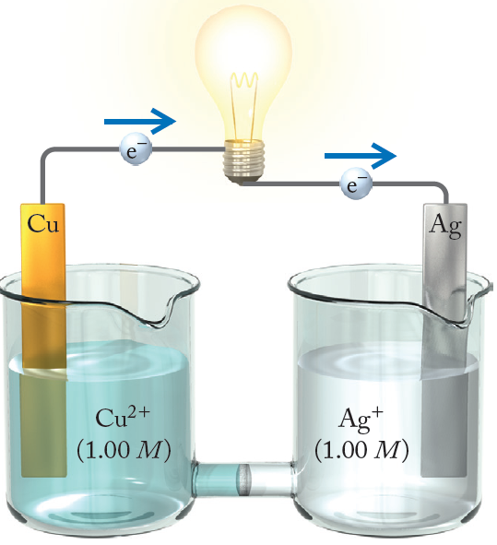
Writing Cell Diagrams
Step 3: Indicate concentrations of dissolved species and partial pressures of any gases (if known)
Cu(s) | Cu²⁺(1.00 M) || Ag⁺(1.00 M) | Ag(s)
anode
cathode
(oxidation half–reaction)
(reduction half–reaction)

Slide 32
Practice: Voltaic Cells
Write the voltaic–cell reaction and write a cell diagram for the cell in which magnesium metal is oxidized to magnesium ions and copper ions are reduced to copper metal.
Mg(s) + Cu²⁺(aq) → Mg²⁺(aq) + Cu(s)
being oxidized
being reduced
Mg(s) | Mg²⁺(aq) || Cu²⁺(aq) | Cu(s)
anode
cathode
(oxidation half–reaction)
(reduction half–reaction)

Slide 33
The following reaction occurs in acidic solution. Identify the correct half–reaction that applies to the reducing agent. (Note: The equation is not balanced.) Cr₂O₇^{2–}(aq) + C₂H₅OH(aq) → C₂H₄O(aq) + Cr³⁺(aq)
Your Turn TopHat: Half Cell Reactions
C₂H₅OH → C₂H₄O + 2H⁺ + 2e–
Cr₂O₇^{2–} + 3e– → Cr³⁺ + 7H₂O
C₂H₅OH + 2e– + 2H⁺ → C₂H₄O + H₂O
14H⁺ + Cr₂O₇^{2–} → 2Cr³⁺ + 7H₂O + 8e–
14H⁺ + Cr₂O₇^{2–} + 6e– → 2Cr³⁺ + 7H₂O
Notes:
Assign redox numbers.

Slide 34
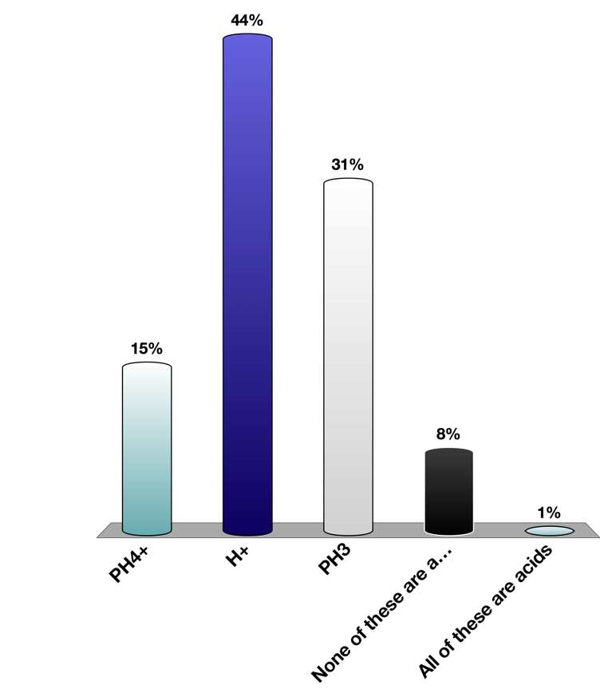
The following reaction occurs in acidic solution. Identify the correct half–reaction that applies to the reducing agent. (Note: The equation is not balanced.) Cr₂O₇^{2–}(aq) + C₂H₅OH(aq) → C₂H₄O(aq) + Cr³⁺(aq)
Your Turn TopHat: Half Cell Reactions
+6
–2
–1
+3
oxidizing agent
reducing agent
oxidation half–reaction
C₂H₅OH(aq) → C₂H₄O(aq)
+ 2H⁺(aq)
+ 2e–
C₂H₅OH(aq) → C₂H₄O(aq) + 2H⁺(aq) + 2e–

Slide 35
A voltaic cell is constructed based on the reaction of Ag(CN)₂–(aq) with Cr(s) producing Ag(s) and Cr³⁺(aq). Identify the correct cell diagram.
Your Turn TopHat: Cell Diagrams
Ag(CN)₂–(aq) | Cr(s) || Ag(s) | Cr³⁺(aq)
Ag(s) | Cr³⁺(aq) || Ag(CN)₂–(aq) | Cr(s)
Cr(s) | Cr³⁺(aq) || Ag(s) | Ag(CN)₂–(aq)
Ag(CN)₂–(aq) | Ag(s) || Cr(s) | Cr³⁺(aq)
Cr(s) | Cr³⁺(aq) || Ag(CN)₂–(aq) | Ag(s)

Slide 36
A voltaic cell is constructed based on the reaction of Ag(CN)₂–(aq) with Cr(s) producing Ag(s) and Cr³⁺(aq). Identify the correct cell diagram.
Your Turn TopHat: Cell Diagrams
overall reaction
Ag(CN)₂–(aq) + Cr(s) → Ag(s) + Cr³⁺(aq) + 2CN–(aq)
+1
0
0
+3
oxidation half–reaction
Cr(s) → Cr³⁺(s) + 3 e–
anode
reduction half–reaction
Ag(CN)₂– + 1e– → Ag(s) + 2CN–
cathode
Cr(s) || Ag(s)
Cr(s) | Cr³⁺(aq) || Ag(CN)₂–(aq) | Ag(s)
anode
cathode
(oxidation half–reaction)
(reduction half–reaction)

